Slide 1
Set up VS Code
Step 1: visit https://code.visualstudio.com/download
to down the editor.
Step 2: Click on the type of operating system (OS) you are currently using, in this case, Windows OS platform.
Step 3: Browse to your Downloads Folder (Double-click the downloaded .exe file)
Step 4: Install VS Code
Click on Accept the agreement
Click Next to proceed through setup steps
Choose installation location (optional)
Leave it at the default location or
Click Browse button and select your own folder (e.g., C:\Visual Studio Code)
Then click next to continue.

Slide 2
Con…
Select additional tasks (recommended):
o Click on Add to PATH
o Click on Register code as an editor for supported file types
o Click on Add “Open with Code” to Windows Explorer context menu
Click Next.
Click Install, then wait for it to finish.
Check the box "Launch Visual Studio Code" and click Finish.
Step 5: Install Live Server Extension , Open the Extensions Panel
Step 6: Use Live Server:

Slide 3
Create a Project Folder
On vs code
Go to File > Open Folder
open it.
Create an HTML File , Inside the folder:
Click New File ,Name it: index.html
o Type HTML Code “ Hello, Live Server!”

Slide 4
Run with Live Server
Right-click on the index.html file
Select “Open with Live Server” or
Click the "Go Live" button in the bottom-right corner of VS Code.
See the Result: Your default web browser will open and display the HTML page, when you make changes or Try editing the text and saving the file, the browser will refresh automatically!

Slide 5
2.3. Setting up Bootstrap
Have two ways of getting Bootstrap.
You can include the Bootstrap 5 link using the content delivery network (CDN)
simply download the Bootstrap 5 website directly to your device using the package manager.

Slide 6
Steps: To download Bootstrap 5 Offline (Option 1)
Step 1: Open your browser and go to the official Bootstrap website, https://getbootstrap.com/docs/5.0/getting-started/download/
Step 2: Download the Compiled CSS and JS code to your computer

Slide 7
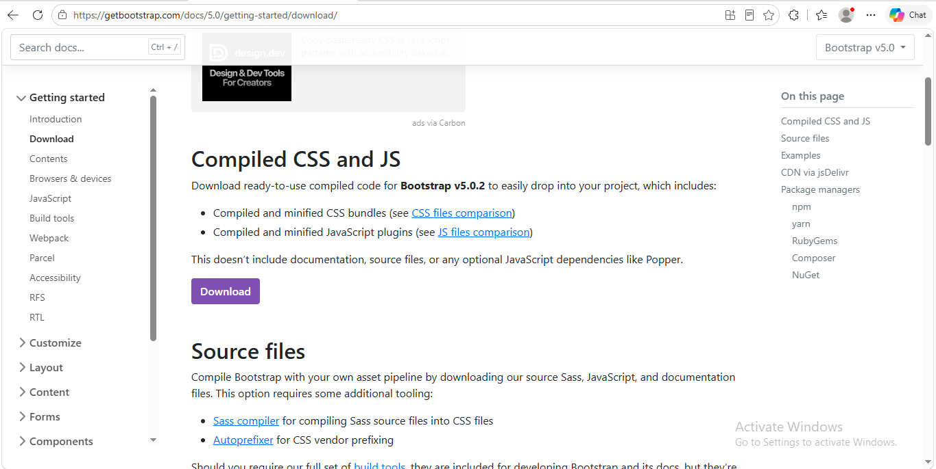
Con…

Slide 8
Con…
Step 3: Locate your Downloads Folder on your computer
Step 4: Extract the compressed bootstrap-5.3.3-dist file and explore the contents
Step 5: As you can see, the CSS Folder contains many files; bootstrap.min.css will be used.
Step 6: JS Folder also contains tons of files, bootstrap.bundle.min.js will be used here.

Slide 9
Con…
Step 6: Copy the bootstrap.min.css and bootstrap.bundle.min.js to the respective CSS and JS Folders on your Web Project Folder respectively.

Slide 10
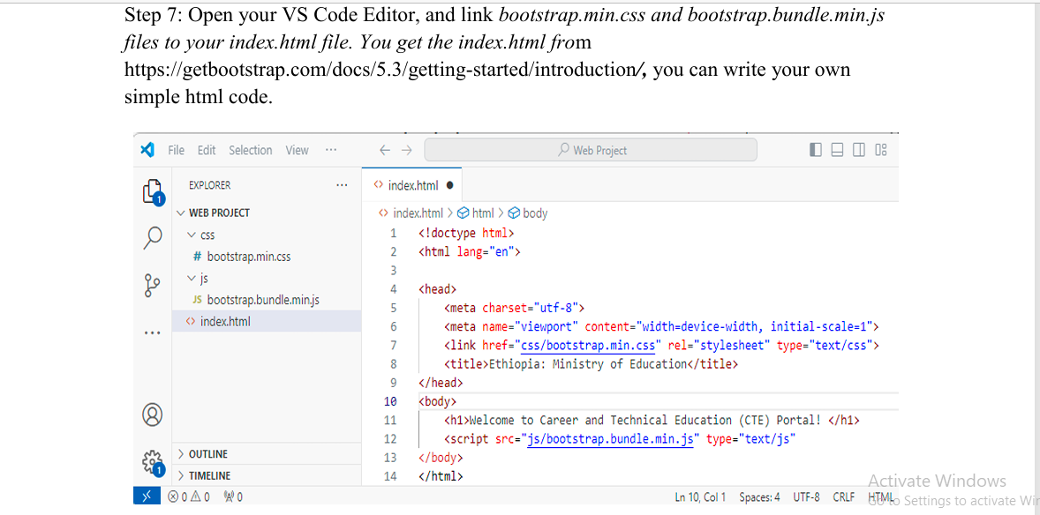
Con…

Slide 11
Steps: Downloading Bootstrap using Content Delivery Network (Option 2)
Firstly, make sure that there is an internet connection in your computer labs to use Content Delivery Network (CDN)
Bootstrap uses jsDelivr (https://www.jsdelivr.com/) as its content delivery network
JsDelivr is one of the most popular content delivery networks for open-source projects.

Slide 12
Con…
The content delivery network helps to deliver web files directly from the Node Package Manager (npm) registry and GitHub repository without any additional configuration on the user side.
CDN helps to improve the time and website performance.
Bootstrap CDN is a free of cost
content delivery network helps us to quickly load Bootstrap CSS, and JavaScript libraries on projects to make projects responsive, mobile friendly, and attractive.

Slide 13
Con..
1. Cascading Style Sheets (CSS)
<link href="https://cdn.jsdelivr.net/npm/bootstrap@5.3.3/dist/css /bootstrap.min.css" rel="stylesheet" integrity="sha384 QWTKZyjpPEjISv5WaRU9OFeRpok6YctnYmDr5pNlyT2bRjXh0JMhjY6hW+A LEwIH" crossorigin="anonymous“>

Slide 14
Con…
2. JavaScript
<script src="https://cdn.jsdelivr.net/npm/bootstrap@5.3.3/dist/js/b ootstrap.bundle.min.js" integrity="sha384 YvpcrYf0tY3lHB60NNkmXc5s9fDVZLESaAA55NDzOxhy9GkcIdslK1eN7N6 jIeHz" crossorigin="anonymous“></script>

Slide 15
2.4. Bootstrap Document Structure
Bootstrap is a powerful and widely-used front-end framework for creating responsive and mobile-first websites.
Its document structure is designed to simplify web development by providing a standardized layout, pre-styled components, and utilities.
At the core of a Bootstrap document is the HTML file, which typically includes references to the Bootstrap CSS and JavaScript files, either through a Content Delivery Network (CDN) or locally hosted files.

Slide 16
Con …
A basic Bootstrap document begins with a standard HTML5 doctype and includes a properly defined `<head>` section with meta tags for responsiveness (`<meta name="viewport" content="width=device-width, initial-scale=1“>`). The Bootstrap CSS file is linked in the `<head>` to ensure consistent styling across all devices.

Slide 17
Con…
The `<body>` contains the main content of the document and utilizes Bootstrap’s grid system for layout.
This grid system, based on rows and columns, allows developers to create flexible and adaptive designs.
Additionally, the document can incorporate Bootstrap's extensive library of pre-styled components, such as buttons, navigation bars, and modals, to enhance functionality and aesthetics.

Slide 18
Con…
JavaScript functionality, including Bootstrap’s interactive components like carousels and dropdowns, is enabled by linking the Bootstrap JavaScript.
This ensures seamless integration of dynamic behaviors within the document.
Bootstrap’s document structure provides a simplified and modular foundation for building responsive websites efficiently

Slide 19
Steps: Create Bootstrap Using CDN
Step 1: Create a new index.html file in your project root. Include the <meta name="viewport“> tag as well for proper responsive behavior in mobile devices.
Bootstrap 5 is designed to respond to mobile devices. Mobile-first styles are part of the basic framework. To ensure proper rendering and zoom touch, add <meta>the following tag within the <head>feature:
<meta name = “viewport” content = “width = device-width, initial-scale= 1” >
Width = part of the device width determines the width of the page to follow the screen width of the device (which will vary depending on the device).
Initial scale section = 1 sets the first zoom level when the page is loaded in the browser.

Slide 20
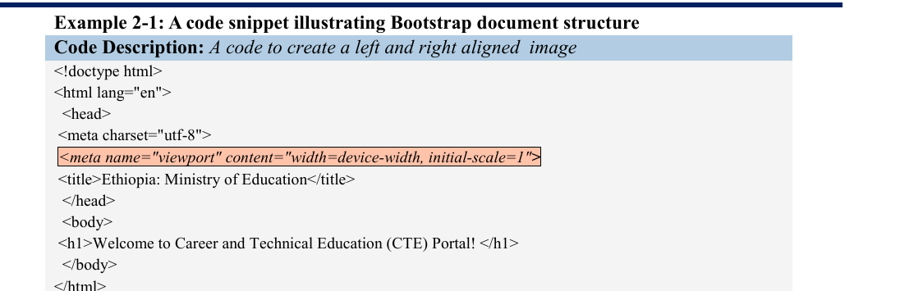
Con…

Slide 21
Con…
Step 2: Include Bootstrap’s CSS and JS. Place the <link> tag in the <head> for our css, and the <script>tag for our JavaScript bundle (including Popper for positioning dropdowns, poppers, and tooltips) before the closing </body>

Slide 22
Con…
<!doctype html>
<html lang="en">
<head>
<meta charset="utf-8">
<meta name="viewport" content="width=device-width, initial-scale=1">
<title> Ethiopia: Ministry of Education </title>
<!-- Bootstrap CSS -->
<link href="https://cdn.jsdelivr.net/npm/bootstrap@5.3.3/dist/css/bootstrap.min.css"
rel="stylesheet" integrity="sha384
QWTKZyjpPEjISv5WaRU9OFeRpok6YctnYmDr5pNlyT2bRjXh0JMhjY6hW+ALEwIH"
crossorigin="anonymous">
</head>
<body>
<h1> Welcome to Career and Technical Education (CTE) Portal! </h1>
<!-- Your content goes here -->
<!-- Bootstrap JavaScript (Optional) -->
<script src="https://cdn.jsdelivr.net/npm/bootstrap@5.3.3/dist/js/bootstrap.bundle.min.js"
integrity="sha384-YvpcrYf0tY3lHB60NNkmXc5s9fDVZLESaAA55NDzOxhy9GkcIdslK1eN7N6jIeHz"
crossorigin="anonymous"></script>
</body>
</html>

Slide 23
Key Components of Bootstrap Document Structure
Meta Tags: The <meta name="viewport" content="width=device-width, initial scale=1.0“> tag ensures proper scaling and responsiveness on all devices.
Bootstrap CSS Link:A link to the Bootstrap CSS style sheet is required to access Bootstrap’s prebuilt styles.
Content Area:The <body>tag contains all the HTML elements and components styled using Bootstrap classes.

Slide 24
Con...
Bootstrap JavaScript:JavaScript functionality (e.g., modals, dropdowns) is enabled by including the Bootstrap JavaScript bundle

